Slide 1
Universal Response Engine: LLMs for Good
Team #35
Client: Ahmed Nazar
Advisor: Mohamed Selim

Slide 2
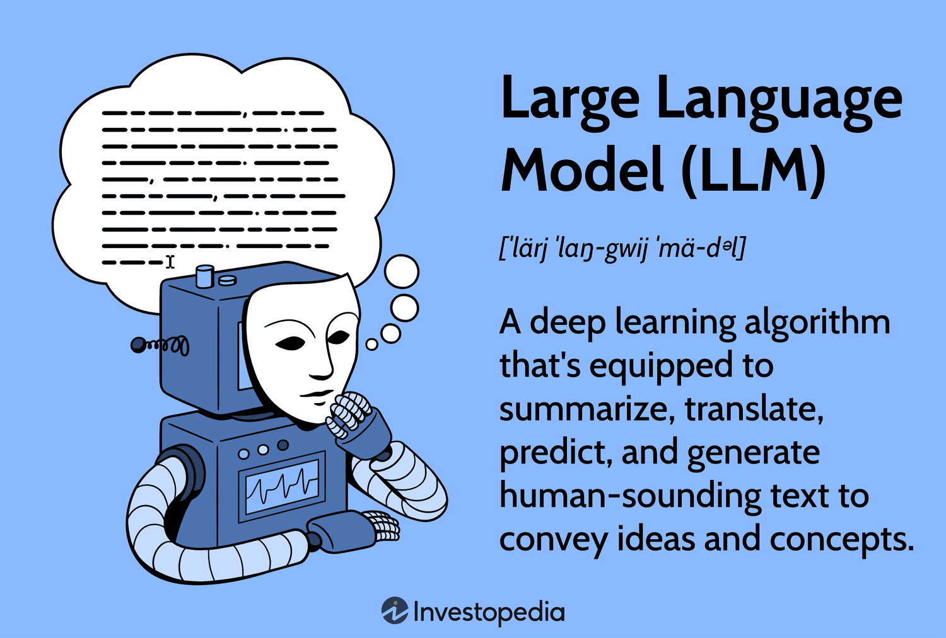
Notes:
What is an LLM?
Go back a few steps…
AI: broad term, intelligent machines
ML: subfield of AI, pattern recognition, predicting data
LLMs: subfield of ML, taking pattern recognition and a combination of other ideas to start generating text, like natural languages, and other data
How do LLMs work?
Combine lots of datasets
Feed data to a neural network that processes it with calculations (like calculating similarity between words)
Finetune it by training it on specific datasets

Slide 3
Project Overview
Creating an LLM for humanitarian use
Chatbot-like website where users provide questions/prompts
Model responds with relevant links, media, info (multimodal)
Notes:
Our project aims to address a critical gap in accessible and comprehensible support for individuals facing challenges. Many people experience difficult circumstances and may feel isolated when seeking help. Although there are a lot of good resources available, they are often fragmented and require these distraught people to sift through multiple pages of information from different sources.
What makes it different: societal good, open-source, no data tracking, to help people in vulnerable situations
Fine-tuned, trained, vetted on empathetic datasets that provide medical advice, emergency advice, etc.

Slide 4
Problem Statement
The lack of a comprehensive platform to provide support to the aforementioned people in need causes:
Increased stress and frustration
Inefficient use of time and energy
Potential oversight of crucial information/services
Inconsistent quality and reliability of info

Slide 5
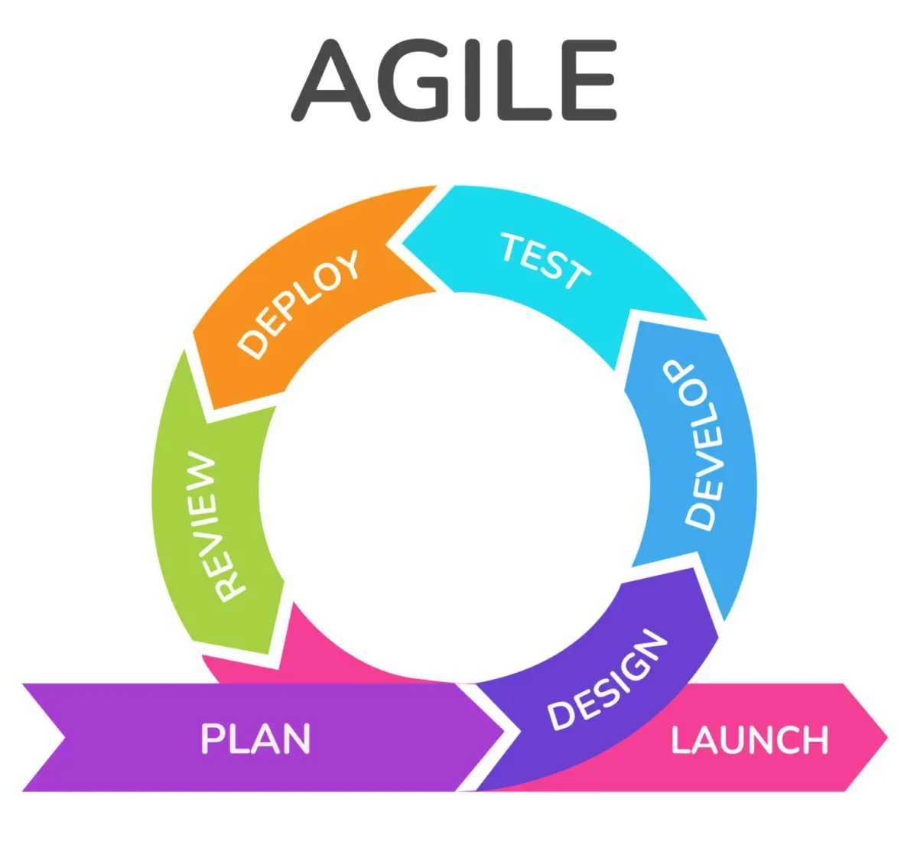
Project Management Style
AGILE
Iterative and incremental style
Every team member has experience with this style
Progressive elaboration
Better risk management
Flexible

Slide 6
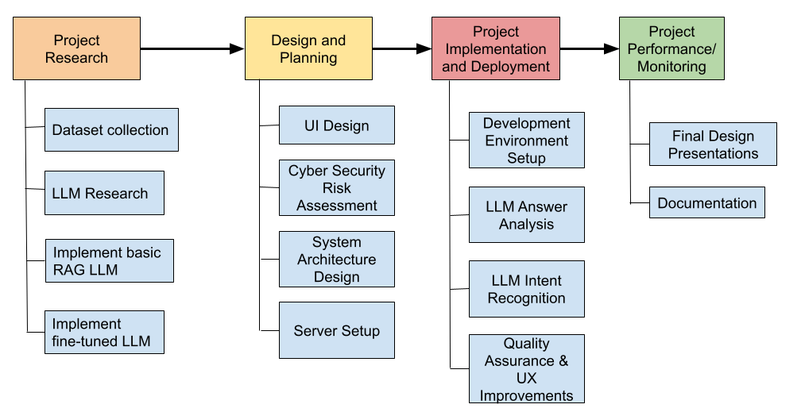
Task Decomposition

Slide 7
Gantt Chart

Slide 8
Milestones, Metrics, & Evaluation Criteria
Milestones
Well-defined and informational dataset collection
A model that is knowledgeable and empathetic
User interface prototype
Metrics
Accuracy: Correctness of responses
User Satisfaction: Feedback on relevance, empathy, and clarity
Evaluation Criteria
Quality of Response: In terms of Depth, relevance, and clarity
UI usability: User-friendly experience

Slide 9
Risk
Risks
Expose user data
Bias and Fairness
Risk Management Strategies
Quality cybersecurity practices and deletion of user data after session is complete
Edit and tailor the datasets fed to our model to decrease the amount of bias

Slide 10
Conclusions
The correct choice of a project management style can result in a better project, especially during development.
Thoroughly and correctly breaking up tasks helps to predict project length and quality.
Proper risk management is important to take into account so that the team is prepared for any mishaps that may occur.

